Slide 1
.lib - liberty file

Slide 2
It contains timing information of standard cells, hard macros.It contains Functionality information of standard cells and soft macros.
.lib file is given by vendors
Timing information like cell delay setup, hold, recovery, removal are present.
PVT corners are also present. for every PVT corner the timing of cells is different. hence for every PVT corner there is a .lib file present.
cell delay is a function of input transition and output load and is calculated based on lookup tables.
cell delays are calculated by Nonlinear Delay Model(NLDM) and composite current source (CCS) models.

Slide 3
.LIB CONTAINS –
FUNCTIONALITY INFORMATION
TIMING INFORMATION
POWER(PVT) INFORMATION
CELL DELAY INFORMATION
FUNCTIONALITY INFORMATION:
it contain information about design cells, standard cells, macro cells, and so on…
Timing information:
It contain timing information of setup and hold time requirements.

Slide 4
Power information
It contain power information like power switching, leakage power and internal power.
PVT Corners
PVT means Process Voltage Temperature
To process the chips after fabrication we check all possible scenarios to make the chip work.
The design needs to be tested for certain PVT corners but for every PVT corner, the timing of cells are different

Slide 5
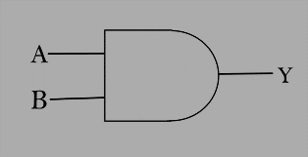
Cell delay information:
It contain input transition and output load based on lookup table.
Unit attributes in .lib file
Time unit
Current unit
Voltage unit
Leakage power unit
Capacitive load unit
Slew rate : Lower and upper limit values are defined in terms of percentage for both rise and fall time
Input and Output threshold for rise and fall time.

Slide 6
CCS (COMPOSITE CURRENT SOURCE) | NLDM (NON LINEAR DELAY MODEL)
It’s like Norton equivalent circuit. | It’s like Thevenin's equivalent circuits.
current source used for driver modeling. | Voltage source used for driver modeling.
It 20 variables to account input transition and output load. | It has only 2 variables.
CCS is more accurate. | Less accurate.
CCS file is 10x times larger than NLDM because of more numbers of variables. | Smaller than CCS file.
Runtime for CCS is more. | Runtime is less.

Slide 7
CCS (composite current source) is used for driver modelling , ccs have 20 variables to account input slew and output load data. Where as NLDM (non-linear delay model) data uses the voltage source for driver modelling and it has only 2 variables which are not sufficient for modelling the non-linearity of circuit.so ccs has more accurate than nldm .Because of the difference in numbers of variable used in both the models , size of ccs file is 10x larger than the nldm file.Also the run time for ccs is more compare to nldm file.

Slide 8
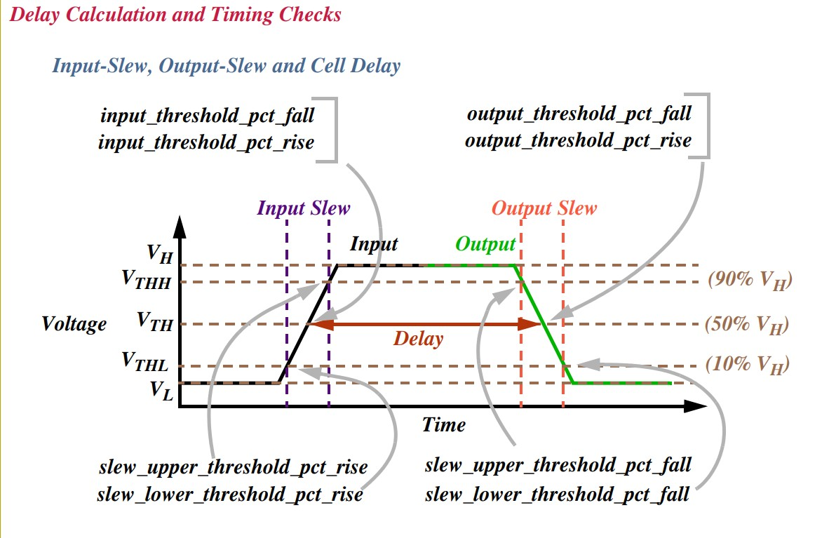

Slide 9
.LIB CONTAINS THE INFORMATION OF:
WIRELOAD:
CAPACITANCE
RESISTANCE
FANOUT LENGTH
SLOPE
AREA
PIN:
FANOUT LENGTH
RELATED POWER PIN
RELATED GROUND PIN
DIRECTION
FALL CAPACITANCE
RISE CAPACITANCE
MAX TRANSITION
INTERNAL POWER-RISE
-FALL
TIMING ():
RELATED PIN
TIMING SENSE
CELL RISE
RISE TRAN
CELL FALL
FALL TRAN
CELL:
CELL FOOTPRINT
AREA
CELL LEKAGEPOWER
DRIVER WAVEFORM RISE
DRIVER WAVEFORM FALL
LEKAGEPOWER-WHEN
-VALUE
PG PIN(VDD)
PG PIN(VSS)

Slide 10
Example :
Cell (AND2_3){
area: 8.000
pin (o){
direction: output;
timing 0{
related _pin: "A";
rise _propagation ( )
}
rise_transition ( )
}
function: "(A & B)";
max_cap;
min_cap;
}
pin (a) {
related power pin = "VDD";
related ground pim = "VSS";
direction : input;
max capacitance : 8 ;
}

Slide 11
LEF (PHYSICAL LIBRARY)
LEF (LIBRARY EXCHANGE FORMAT)
Thank you …

Slide 12
LEF :
LEF Contains the physical information of a cell.
The lef file gives the Vendors.
The LEF file is the abstract view of cells.
It only gives the idea about PR boundary, pin position and metal layers information of a cell.
To get the complete information about the cell, DEF(Design exchange format) file is required.
In this lef 3 sections are defined i.e. technology, site, macros.

Slide 13
In the technology part layers, design rule, via definitions and metal capacitance are defined.
in the site , site extension is defined .
In the macros the information of about cell description, dimension, layout of pins and blockages and capacitance are defined.
In this lef technology for every layer and the via statements are different .
So for the layer and via , the type of the layer width/pitch and spacing, direction, resistance and antenna factor are defined.

Slide 14
The .lef cell is classified into two types
CELL lef and TECH lef.
CELL LEF:
CELL lef Contains the physical info of macros and std cells.
It contains the direction of input and output pins, signal, ports,
antenna area , size of the cell, symmetry of the cell, pin location,
pin name , site unit , origin , class core.

Slide 15
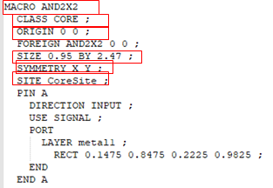
Example of cell lef

Slide 16
TECHNOLOGY LEF:
Tech lef Contains the physical info of metal layers , vias information.
It contains the layer P0 in
type masterslice
Layer C0 in
type cut and spacing
Layer M1
type routing , directional , pitch, width, area, max width,
min width , min density , max density , density check window ,ect..

Slide 17
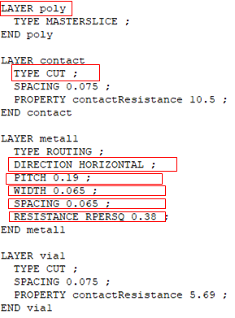

Slide 18
Physical libraries format is in .lef
Physical information of std cells, macros, pads.
Pin information.
Minimum width of resolution.
Height of the placement rows.
Preferred routing directions.
Pitch of the routing tracts.
Antenna rules.
Routing blockage

Slide 19
Antenna ratio= metal area/gate area.
In physical information height, area, width are present and also it
constraints two vias.
Cell View : in this layer all info is present and it is used at the time of
tape out.
Fram View : in fram view is abstract view and it is used at the placement and routing.

Slide 20
NETLIST FILE(.V)

Slide 21
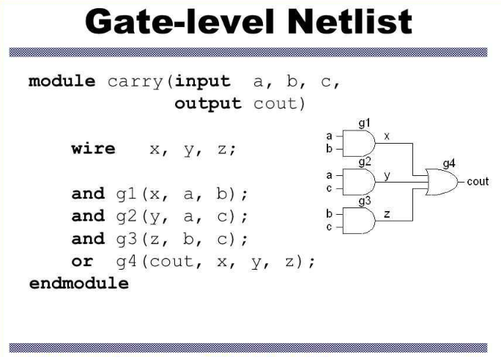
What is a netlist
A netlist is a textual description of a circuit made of components.
It contain information about
Module Information
Inputs
Outputs
Wires
Hierarchy Information
It has extension of .v/.vg
It is given by Synthesis people

